Slide 1

Arabic Autocomplete System

Slide 2

Model Architecture and Base Model
Uses aubmindlab/aragpt2-base as foundation
Pre-trained Arabic GPT-2 model
Transformer-based architecture

Slide 3
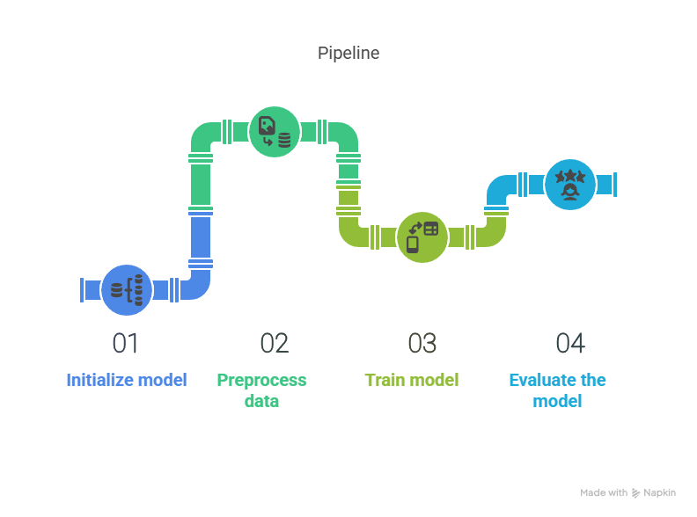

Slide 4
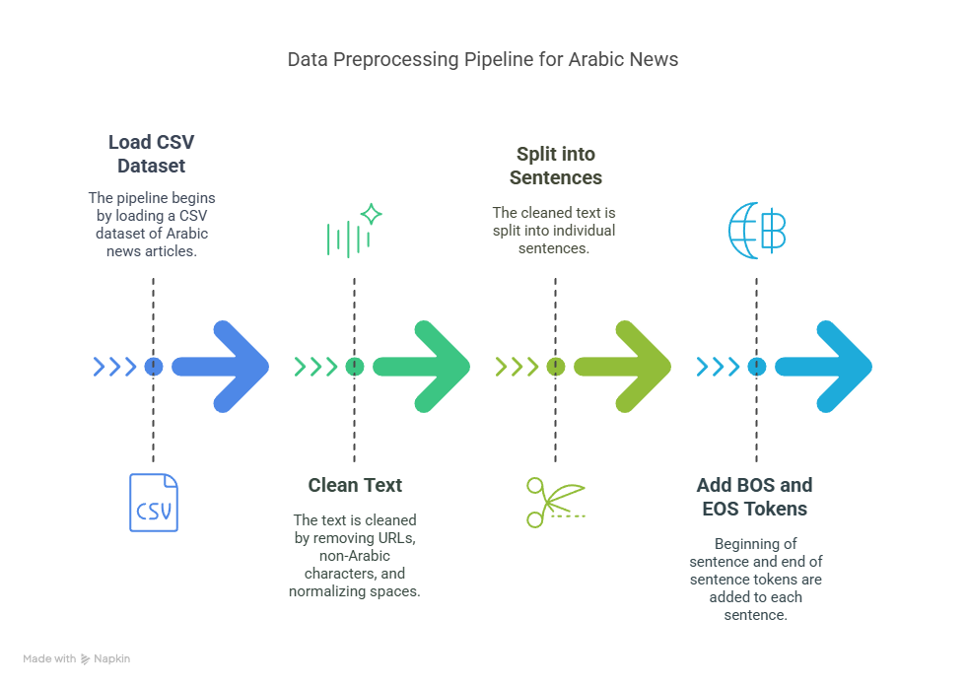

Slide 5
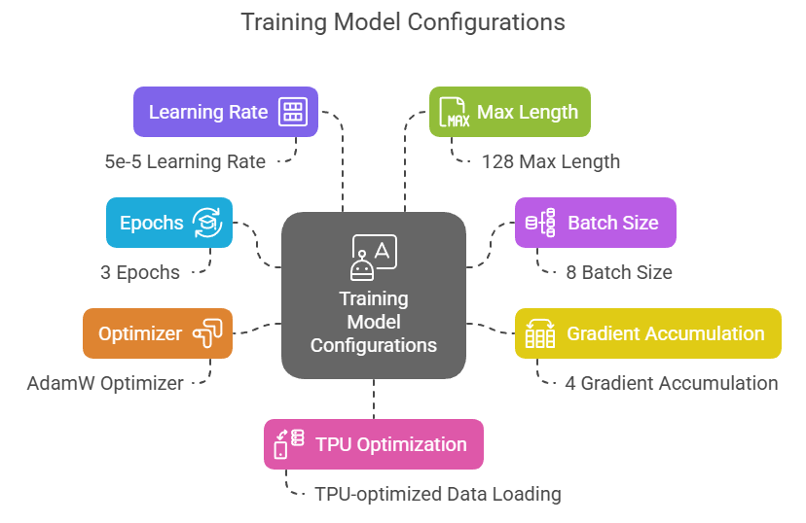

Slide 6
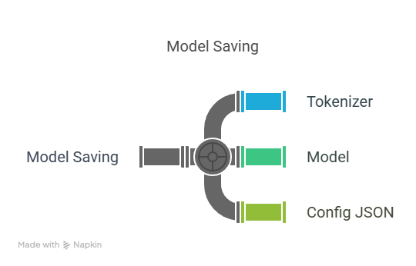

Slide 7
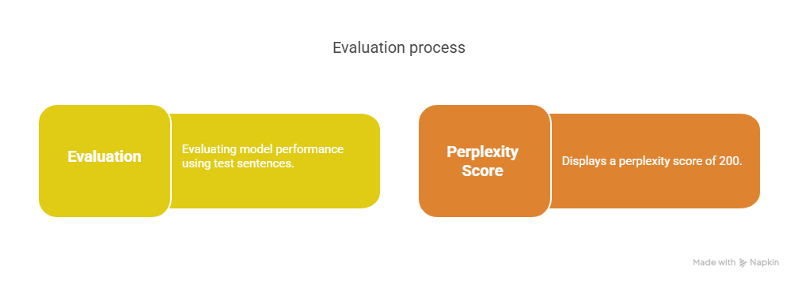

Slide 8
